Slide 1
Inter Process Communication

Slide 2
Process
The process (job / task) created by OS is the OS’s abstraction for execution.
an environment in which a program executes
the dynamic execution context
Each process has
Body of code (data/text) to execute
Reserved piece of memory
Own set of file descriptors
Unique process id
Note that process is not a program but each program can have multiple process running concurrently

Slide 3
UNIX process requires a fair amount of "overhead". Processes contain information about program resources and program execution state, including:
Process ID, process group ID, user ID, and group ID
Environment
Working directory.
Program instructions
Registers, stack, Heap
File descriptors
Signal actions
Shared libraries
Inter-process communication tools (such as message queues, pipes, semaphores, or shared memory).

Slide 4
Concurrent programming
Program runs as more than one process
Essentially more than one control flow
Do not happen at the same time on CPU
Processes within a system may be independent or cooperating
Independent – It cannot affect or be effected by the other processes executing in the system – Does not share any data with any other processes
Cooperating - It can affect or be affected by the other processes executing in the system.
Brings New programming challenge
To achieve the common objective of the program need to establish the cooperation between the process

Slide 5
Inter-process Communication
Reasons for cooperating processes:
Information sharing
Computation speedup
Modularity
Convenience
Privilege separation
Cooperating processes need inter-process communication (IPC)
Mechanisms provided by OS

Slide 6
Inter-process Communication
A mechanism that allow co-operating processes to exchange data and information.
Two fundamental models:
Shared-Memory Mapping
Accomplished by mapping addresses to common DRAM!
Read and Write through memory
Message Passing
send() and receive() messages
Works across network

Slide 7
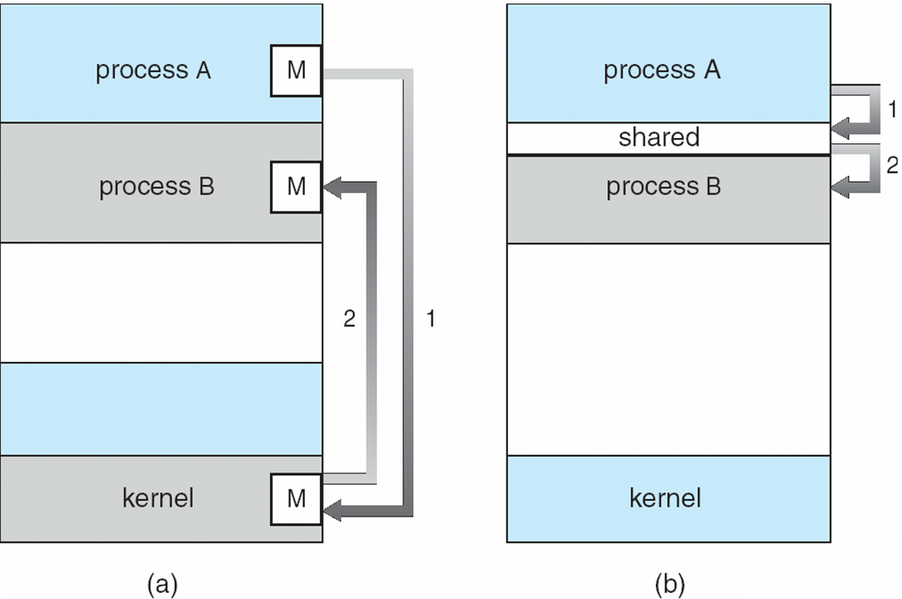
Message passing
Shared memory
Message passing
Shared memory
Exchange small amount of data via kernel using system calls
Establish shared memory regions.
Faster communication as Direct memory access

Slide 8
Inter Process Communication
Mechanism for processes to communicate and to synchronize their actions.
Message system – processes communicate with each other without resorting to shared variables.
IPC facility provides two operations:
send(message) – message size fixed or variable
receive(message)
If P and Q wish to communicate, they need to:
establish a communication channel between them
exchange messages via send/receive

Slide 9
Producer-Consumer
void Producer() {
while (TRUE) {
/* produce */
build_message(&m, item);
/* send message */
send(consumer, &m);
/* wait for ack */
receive(consumer, &m);
}
}
void Consumer {
while(TRUE) {
receive(producer, &m);
/* receive message */
extract_item(&m, &item);
/* send ack */
send(producer, &m);
/* consume item */
}
}

Slide 10
Synchronization in message passing
 | Synchronous | Asynchronous
Send | blocked until the message is received message queue is full | Returns as soon as I/O started Blocks if buffer is full
Receive | Returns if there is a message Blocks until a message arrives | Returns if there is a message Returns indication if no message
Blocking Send & Receive -> tight sync
Non Blocking Send & Receive
Nob Blocking Send & Blocking Receive -> Most popular.

Slide 11
Name | Description
File | record stored on disk, accessed by any process using name
Signal | system message sent from one process to another, to give commands SIGKILL, SIGSTOP, etc,.
Socket | A data stream to, different process on the same or diff computer, client/server sys.
Pipe | data stream; interfaced through standard I/O; read cha by cha.
Named pipe | Give name to pipe; use a file in the file system instead of standard I/O.
Shared memory | Multiple processes acting on the same memory (R/W)
Message queue | data stream similar to the pipe, but information in packets supported by Kernel.
Semaphore/Mutex | Synchronization of threads or processes
Message passing(shared nothing) | Similar to the message queue.
Memory-mapped file | Similar to file but mapped to RAM and can be modified by changing memory addresses

Slide 12
IPC
Using Files
Between parent and child
Parent creates two files before fork()
Child inherits file descriptor from parent & share the file pointers
Can use one for parent to write and child to read and other for vice versa
Requires involving hard disc I/o and results in poor performance

Slide 13
Pipes
Similar to two file descriptors (int fd[2])
By pass hard disc; implies less overhead
Read from fd[0], write to fd[1] in FIFO order, & vice versa
Pipe - byte stream buffer in kernel
Sequential (can’t lseek())
Multiple readers/writers difficult
Unidirectional
Write end + read end
Notes:
Pipe and fifo difference

Slide 14
Pipes
ls | wc -l
Pipe
ls stdout (fd1)
Byte stream: Unidirectional
Stdin (fd 0) wc
Write end of pipe
Read end of pipe
Piping is a process where the output of one process is made the input of another.

Slide 15
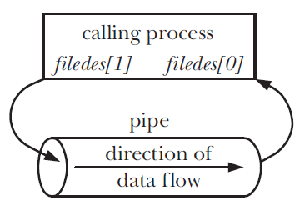
Creating and using pipe
Create using pipe():
int filedes[2];
pipe(filedes);
Use
write(filedes[1], buf, count);
read(filedes[0], buf, count);
Pipes are anonymous
No name in file system
How do two processes share a pipe?

Slide 16
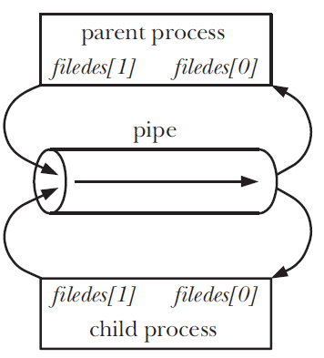
Sharing a pipe
int filedes[2];
pipe(filedes);
child_pid = fork();
if (child_pid == 0) {
close(filedes[1]);
/* Child now reads */
} else {
close(filedes[0]);
/* Parent now writes */
}
fork() duplicates parent’s file descriptors

Slide 17
I/O in pipe
Parent and child must close unused descriptors
Necessary for correct use of pipes!
close() write end
read() returns 0 (EOF)
close() read end
write() fails with EPIPE error + SIGPIPE signal
read() blocks if pipe is empty
write() blocks if pipe is full

Slide 18
Sample Program
#include <unistd.h>
#include <stdio.h>
#include <string.h>
int main(int *argc, char **argv)
{
int pfd[2];
pipe(pfd); /* Create the pipe */
switch (fork()) {
case 0: /* Child - reads from pipe */
close(pfd[1]); /* Write end is unused */
char buf[100];
int BUF_SIZE=100;
int numRead=0;
for (;;) { /* Read data from pipe, echo on stdout */
numRead = read(pfd[0], buf, BUF_SIZE);
if (numRead <= 0) break; /* End-of-file or error */
write(STDOUT_FILENO, buf, numRead);
}
write(STDOUT_FILENO, "\n", 1);
close(pfd[0]);
default: /* Parent - writes to pipe */
close(pfd[0]); /* Read end is unused */
write(pfd[1], argv[1], strlen(argv[1]));
close(pfd[1]); /* Child will see EOF */
}
return 0;
}

Slide 19
FIFO (named pipe)
(Anonymous) pipes can only be used by related processes
FIFOs - pipe with name in file system
Creation:
mkfifo(pathname, permissions)
mkfifo command
Any process can open and use FIFO
I/O is same as of pipes

Slide 20
Named PIPE Example - Writer
#include <stdio.h>
#include <sys/types.h>
#include <sys/stat.h>
#include <fcntl.h>
#include <string.h>
char * phrase = "Hello, this is my first named pipe example";
int main () {
int fd1;
fd1 = open ("/tmp/mypipe", O_WRONLY ); /*open Write end */
write (fd1, phrase, strlen ( phrase)+1 );
close (fd1);
}

Slide 21
Named PIPE Example - Reader
#include <stdio.h>
#include <sys/types.h>
#include <sys/stat.h>
#include <fcntl.h>
int main () {
int fd1;
char buf [100];
fd1 = open ( "/tmp/mypipe", O_RDONLY ); /*open Read end */
read ( fd1, buf, 100 );
printf ( "%s\n", buf );
close (fd1);
}

Slide 22
PIPEs Vs Named PIPEs
PIPE
Between the processes which share the same file descriptor table (normally the processes and the child processes or threads created by them)
Named PIPE
Don't have to start the reading/writing processes at the same time
Can have multiple readers/writers which do not need common ancestry
Can control ownership and permissions
Across different systems – If a common file system available

Slide 23
IPC through Shared variables
Process could communicate through variables that are shared
Variables in different virtual memory pointing to same physical location
Address translation is to protect one process from other (heap, stack, text, data, etc.,)
Special OS supports for program to specify objects that are to be in shared regions and address space
System calls involves traps

Slide 24
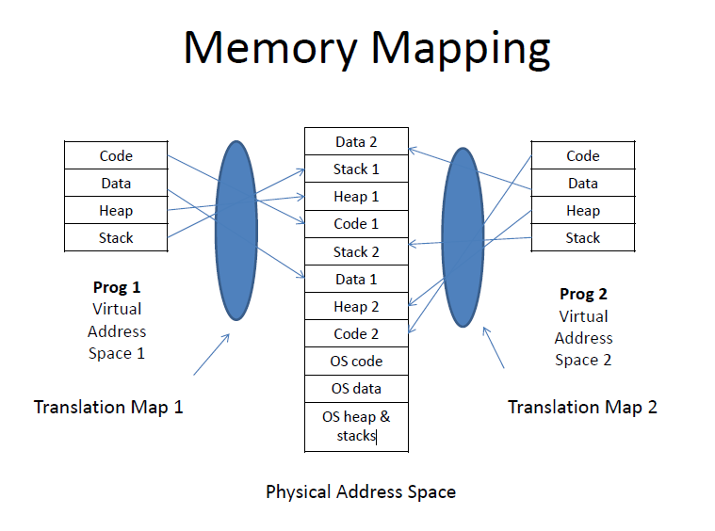

Slide 25
Message Queues
Two (or more) processes can exchange information via access to a common system Message Queue
Message queues can be best described as an internal linked list within the kernel's addressing space
Messages can be sent to the queue in order and retrieved from the queue in several different ways
Each message & Message Queue is uniquely identified by an IPC identifier

Slide 26
MQ and PIPE
Message queue is better than pipe. This is because, in pipe, you have to decide the protocol used for communication.
A stream is taken from a pipe and you have to parse the bytes and separate them into packets.
The data sent through pipes is in FIFO order. This means that you need to use all the bytes sent before requesting for any other stream.

Slide 27
Message Queues
Process A
Process B
User
Space
M
M
Message Queue
Type
Message
Kernel
Space

Slide 28
Steps in Message Passing with Message Queues
Initialize Queue
Initialize Queue
Send Message
Receive Message
Remove the Message Queue

Slide 29
Message Queue
In a message queue, the sending process calls a system routine for placing the message in a queue that can be read by another process.
When a message is sent, the entire message is copied to the message queue.
Each process is provided identification or a type, which allows other processes to identify and select it.
A common key is shared between processes accessing the queue.
In Unix, all the functions related to messages are defined in the system file, <sys/msg.h>.

Slide 30
Sending Message
#include <sys/types.h>
#include <sys/ipc.h>
#include <sys/msg.h>
#include <stdio.h>
#include <string.h>
#include <stdlib.h>
#define MAXSIZE 128
struct msgbuf
{
long mtype;
char mtext[MAXSIZE];
};
main()
{
int msqid;
int msgflg = IPC_CREAT | 0666;
key_t key;
struct msgbuf sbuf;
size_t buflen;
key = 1234;
if ((msqid = msgget(key, msgflg )) < 0){ //Get the message queue ID for the given key
perror("msgget");
exit(1);
}
//Message Type
sbuf.mtype = 1;
printf("Enter a message to add to message queue : ");
scanf("%[^\n]",sbuf.mtext);
getchar();
buflen = strlen(sbuf.mtext) + 1 ;
if (msgsnd(msqid, &sbuf, buflen, IPC_NOWAIT) < 0)
{
printf ("%d, %d, %s, %d\n", msqid, sbuf.mtype, sbuf.mtext, buflen);
perror("msgsnd");
exit(1);
}
else
printf("Message Sent\n");
exit(0);
}

Slide 31
Receiving Message
#include <sys/types.h>
#include <sys/ipc.h>
#include <sys/msg.h>
#include <stdio.h>
#include <stdlib.h>
#define MAXSIZE 128
typedef struct msgbuf
{
long mtype;
char mtext[MAXSIZE];
};
main()
{
int msqid;
key_t key;
struct msgbuf rcvbuffer;
key = 1234;
if ((msqid = msgget(key, 0666)) < 0)
{
perror("msgget()");
exit(1);
}
//Receive an answer of message type 1.
if (msgrcv(msqid, &rcvbuffer, MAXSIZE, 1, 0) < 0)
{
perror("msgrcv");
exit(1);
}
printf("%s\n", rcvbuffer.mtext);
exit(0);
}

Slide 32
Shared Memory

Slide 33
Shared Memory
Same physical page of the memory is shared between processes.
Communication means copy data to memory
One process creates the memory; other process, having appropriate permissions accesses the memory.
In System V, the shared memory allows several processes to attach a segment of physical memory to their virtual addresses.
Shared memory

Slide 34
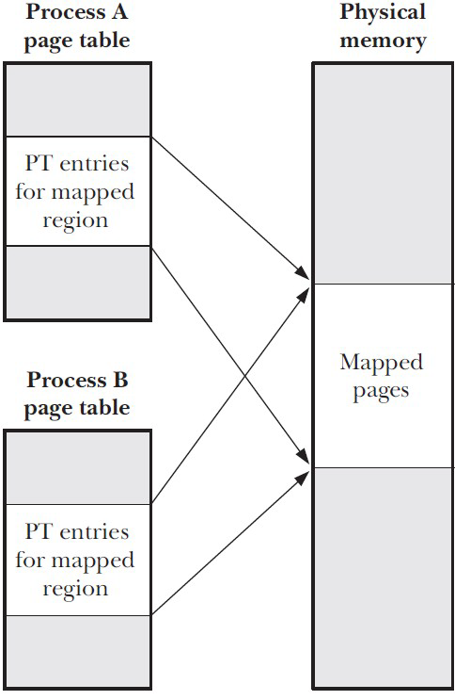
Shared memory
Processes share physical pages of memory
Single copy in user space
Efficient compared to Data transfer
Data transfer: user space -> kernel -> user space

Slide 35
Shared Memory - Server
#include <stdio.h>
#include <stdlib.h>
#include <string.h>
#include <sys/types.h>
#include <sys/ipc.h>
#include <sys/shm.h>
#define SMSIZE 100
int main (int argc, char *argv[])
{
int shmid;
key_t key;
char *shm;
char *s;
key=9876;
shmid=shmget(key,SMSIZE, IPC_CREAT | 0666);
if(shmid <0)
{
perror("shmget");
exit(1);
}
shm = shmat(shmid, NULL, 0);
if(shm == (char *)-1)
{
perror("shmat");
exit(1);
}
memcpy(shm,"hello world",11);
s=shm;
s+=11;
*s=0;
while(*shm != '*')
sleep(1);
return 0;
}

Slide 36
Shared Memory Client
#include <stdio.h>
#include <stdlib.h>
#include <string.h>
#include <sys/types.h>
#include <sys/ipc.h>
#include <sys/shm.h>
#define SMSIZE 100
int main (int argc, char *argv[])
{
int shmid;
key_t key;
char *shm;
char *s;
key=9876;
shmid=shmget(key,SMSIZE, 0666);
if(shmid <0)
{
perror("shmget");
exit(1);
}
shm = shmat(shmid, NULL, 0);
if(shm== (char *)-1)
{
perror("shmat");
exit(1);
}
for(s=shm;*s!=0;s++)
printf("%c",*s);
printf("\n");
*shm='*';
return 0;
}

Slide 37
Some time process don’t need to communicate explicate values
They might need to sync their activities.
Consider the shared value program in which both process increment variable
shared int I =0;
P1: p2:
i++; i++;
What is the value of i after this?
Remember that i++ compiles something like this in Assembly
LW R1 i
Add R1 R1, 1
SW i R1

Slide 38
How to prevent two process updating
shared memory at the same time?
Sync primitives semaphore, mutex, barrier
Identification of critical section; allow the process access this section one at a time (mutual exclusion)
Mutex Lock
Acquire Lock() ;
Done before critical section
return when safe for other process to enter
Release lock();
Done after critical section
allows process to acquire the lock

Slide 39
Implementing a Lock
Int L = 0; /* 0: lock is available L=1 lock in use
AcquireLock(L)
While( L==1) ; /*Busy waiting,
L =1 /*can’t put the process in to /*waiting state for preempting scheduling policy
ReleaseLock(L)
L=0
Mutex, spin wait lock, spinlock, Busy wait lock

Slide 40
Busy wait lock implementation
Hardware support to implement a lock
Test&Set instruction
Test&Set Lock{ tmp=Lock; Lock = 1; return tmp;}
Machine instruction with one memory operand
Its atomic read modify write instructions(RMW) all 3steps happen as one operation
AcquiredLock()
while (test&set(L) /* busy wait until L is test & set from 0 to 1 im plies return value is 0
ReleaseLock()
L=1;

Slide 41
Semaphore
a semaphore is an integer value.
A process waits for permission to proceed by waiting for the integer to become 0.
If the process proceeds after the signal, it may increment the integer by 1.
When the process is completed, it changes the semaphore’s value by subtracting 1 from the integer.

Slide 42
Semaphore
The basic functionality of a semaphore is that you can either set it, check it, or wait until it clears then set it ("test-n-set")
Operations : P(wait) and V(signal)
P(S)
if S is nonzero decrement S and returns;
else blocks process until S become nonzero
implies process restarted decrements s and returns
V(S)
increment S by 1;
one among the blocked process is restarted

Slide 43
Mutual exclusion by call to p(s) make semaphore to 0 and 1 by calling to V(S)
Initialize Semaphore S=1;
P(s) {
if (s!=0), s– return; else block process until s!=0; s– return;}
Critical section
V(s) = {s++; unblocks a process blocked on s}
Semaphore s1=0; s2=0;
Process1 :read ; v(s1)
Process 2: P(s1); claulate, V(s2)
Process 3: p(s2) write;

Slide 44
Deadlock and Starvation
Starvation occurs when one or more threads /process in your program are blocked from gaining access to a resource
Deadlock, the ultimate form of starvation, occurs when two or more process are waiting on a condition that cannot be satisfied
process waiting for the resources held by others while holding the resource need by others.
Process AcquireLock(), AcquireLock()

Slide 45
Producer-Consumer problem
Producer : Produce and write to the shared buffer
Consumer: Consume by reading the shared buffer
Producer must ensure not to write in a full buffer
consumer should not read from empty buffer
They need to sync the access to the buffer and treat access to the buffer as critical section hence need mutual exclusion
Hence problem of both sync & Mutex

Slide 46
Shared buffer[0….n-1] /*critical section
Producer : repeatedly {
produce x;
if (buffer == full) wait for consumption /*mutex
buffer [++i]= x;
signal consumer; /*Semaphore
}
Consumer : repeatedly{
if (buffer == empty) wait for production
y = buffer[--i];
consume y;
signal producer;
}

Slide 47
Dining Philosophers Problem

Slide 48
Dining Philosophers Problem
N philosopher sitting around a circular table with a plate of food in front of each and a fork between each 2 philosopher
Philosopher does: repeatedly
Eat( using 2 forks)
Think
Problem: avoid dead lock; be fair to all

Slide 49
Data movement
PIPE
Byte Stream
FIFO
Stream Socket
Data Transfer
POSIX MQ
Message
Datagram Socket
Sys V MQ
Communication
POSIX SHMEM
Shared Memory
SysV SHMEM
Memory Mapping
Notes:
In a system with fixed memory
the address space of a process occupies and is limited to a portion of the system's main memory.
virtual memory lets applications occupy much larger address spaces.
With mapping, any part of any readable or writable file can be logically included in a process's address space. Like any other portion of the process's address space, no page of the file is not actually loaded into memory until a page fault forces this action.
mmap()
munmap()

Slide 50
Synchronization
POSIX Semaphore
Semaphore
SysV Semaphore
Communication
Mutex
Thread related
Conditional Var.
Barrier
R/W Lock

Slide 51
Interface | Message queues | Semaphores | Shared memory
Header file <sys/types.h> | <sys/msg.h> | <sys/sem.h> | <sys/shm.h>
Associated data structure | msqid_ds | semid_ds | shmid_ds
Create/open object | msgget() | semget() | shmget()+shmat()
Close object |  |  | shmdt()
Control operations | msgctl() | semctl() | shmctl()
Performing IPC | msgsnd()—write message, msgrcv()—read message | semop()—test/adjust semaphore | access memory in shared region

Slide 52
Interface | Message queues | Semaphores | Shared memory
Header file
Object handle | mqd_t | sem_t * | int (file descriptor)
Create/open | mq_open() | sem_open() | shm_open() + mmap()
Close | mq_close() | sem_close() | munmap()
Unlink | mq_unlink() | sem_unlink() | shm_unlink()
Perform IPC | mq_send(), mq_receive() | sem_post(), sem_wait(), sem_getvalue() | operate on locations in shared region
Miscellaneous operations | mq_setattr() —set attributes, mq_getattr() —get attributes, mq_notify()—request notification | sem_init()—initialize unnamed semaphore, sem_destroy()—destroy unnamed semaphore | (none)

Slide 53
Important Note
If you did not remove your shared memory segments they will be in the system forever. This will degrade the system performance.
Use the ipcs command to check if you have shared memory segments left in the system
Use the ipcrm command to remove your shared memory segments.

Slide 54
Mutex
Mutex is an abbreviation for "mutual exclusion". Mutex variables are one of the primary means of implementing thread synchronization and for protecting shared data when multiple writes occur.
Mutexes can be used to prevent "race" conditions.

Slide 55
Mutex Calls in POSIX
The pthread_mutexattr_init() and pthread_mutexattr_destroy() routines are used to create and destroy mutex attribute objects respectively.
The pthread_mutex_lock() - to acquire a lock on the specified mutex variable.
If the mutex is already locked by another thread, this call will block the calling thread until the mutex is unlocked.

Slide 56
Mutex Calls in POSIX
pthread_mutex_trylock() will attempt to lock a mutex. However, if the mutex is already locked, the routine will return immediately with a "busy" error code.
pthread_mutex_unlock() will unlock a mutex if called by the owning thread. Calling this routine is required after a thread has completed its use of protected data

Slide 57
Thread Example Without Mutex
#include<stdio.h>
#include<string.h>
#include<pthread.h>
#include<stdlib.h>
#include<unistd.h>
pthread_t tid[2];
int counter;
void* doSomeThing(void *arg)
{
unsigned long i = 0;
counter += 1;
printf("\n Job %d started\n", counter);
for(i=0; i<(0xFFFFFFFF);i++);
printf("\n Job %d finished\n", counter);
return NULL;
}
int main(void)
{
int i = 0;
int err;
while(i < 2)
{
err = pthread_create(&(tid[i]), NULL, &doSomeThing, NULL);
if (err != 0)
printf("\ncan't create thread :[%s]", strerror(err));
i++;
}
pthread_join(tid[0], NULL);
pthread_join(tid[1], NULL);
return 0;
}

Slide 58
Mutex
A Mutex is a lock that we set before using a shared resource and release after using it.
When the lock is set, no other thread can access the locked region of code.
Even if thread 2 is scheduled while thread 1 was not done accessing the shared resource and the code is locked by thread 1 using mutexes then thread 2 cannot even access that region of code. So this ensures a synchronized access of shared resources in the code.

Slide 59
Thread Example with Mutex
int main(void)
{
int i = 0;
int err;
if (pthread_mutex_init(&lock, NULL) != 0)
{
printf("\n mutex init failed\n");
return 1;
}
while(i < 2)
{
err = pthread_create(&(tid[i]), NULL, &doSomeThing, NULL);
if (err != 0)
printf("\ncan't create thread :[%s]", strerror(err));
i++;
}
pthread_join(tid[0], NULL);
pthread_join(tid[1], NULL);
pthread_mutex_destroy(&lock);
return 0;
}
#include<stdio.h>
#include<string.h>
#include<pthread.h>
#include<stdlib.h>
#include<unistd.h>
pthread_t tid[2];
int counter;
pthread_mutex_t lock;
void* doSomeThing(void *arg)
{
pthread_mutex_lock(&lock);
unsigned long i = 0;
counter += 1;
printf("\n Job %d started\n", counter);
for(i=0; i<(0xFFFFFFFF);i++);
printf("\n Job %d finished\n", counter);
pthread_mutex_unlock(&lock);
return NULL;
}

Slide 60
Example with Mutex
A mutex is initialized in the beginning of the main function.
The same mutex is locked in the ‘doSomeThing()’ function while using the shared resource ‘counter’
At the end of the function ‘doSomeThing()’ the same mutex is unlocked.
At the end of the main function when both the threads are done, the mutex is destroyed.

Slide 61
Mutex Vs Semaphore
Consider the standard producer-consumer problem.
Assume, we have a buffer of 4096 byte length. A producer thread will collect the data and writes it to the buffer.
A consumer thread will process the collected data from the buffer. Objective is, both the threads should not run at the same time.

Slide 62
Using Mutex:
A mutex provides mutual exclusion, either producer or consumer can have the key (mutex) and proceed with their work. As long as the buffer is filled by producer, the consumer needs to wait, and vice versa.
At any point of time, only one thread can work with the entire buffer.

Slide 63
Using Semaphore:
A semaphore is a generalized mutex. In lieu of single buffer, we can split the 4 KB buffer into four 1 KB buffers (identical resources). A semaphore can be associated with these four buffers. The consumer and producer can work on different buffers at the same time.

Slide 64
Mutex Vs Semaphore
Mutex is locking mechanism used to synchronize access to a resource
Semaphore is signaling mechanism (“I am done, you can carry on” kind of signal).

Slide 65
Thank you!

